Slide 1
CMSC 471
ML: Bagging

Slide 2
What’s better than a tree?
14.5

Slide 3
Random Forest
Can often improve performance of decision tree classifiers using a set of decision trees (a forest)
Each tree trained on a random subset of training data
Classify a data instance using all trees
Combine answers to make classification
E.g., vote for most common class

Slide 4
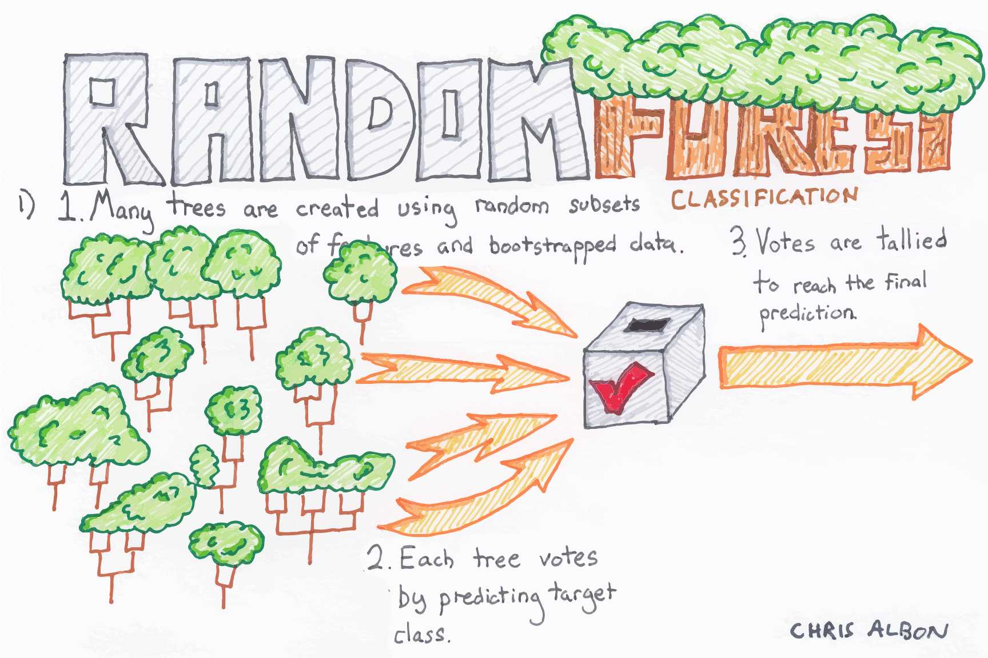

Slide 5
cf. Wisdom of the Crowd
Statistician Francis Galton observed a 1906 contest to guess an ox’s weight at a country fair. 800 people entered. He noted that their average guess (1,197lb) was very close to the actual weight (1,198lb)
When getting human annotations training data for machine learning, standard practice is get ≥ 3 annotations and take majority vote
cf. abbreviation (short for Latin: confer/conferatur) refer reader to other material to make a comparison

Slide 6
Random Forests Benefits
Decision trees not the strongest modeling approach
Random forests make them much stronger
=> more robust than a single decision tree
Limit overfitting to given dataset
Reduce errors due to training data bias
Stable performance if some noise added to training data

Slide 7
Bagging
Idea can be used on any classifier!
Improve classification by combining classifications of randomly selected training subsets
Bagging = Bootstrap aggregating
An ensemble meta-algorithm that can improve stability & accuracy of algorithms for statistical classification and regression
Helps avoid overfitting
AKA ensembling

Slide 8
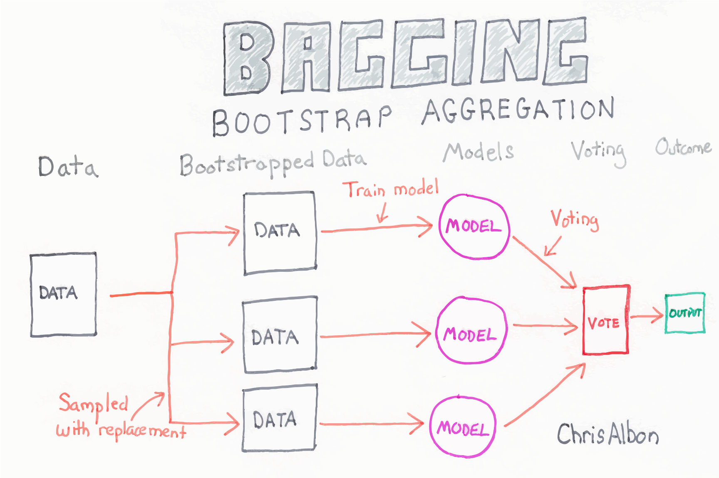

Slide 9
Choosing subsets of training data
Classic bagging: select random subset of training instances with replacement
Pasting: select random subset of training instances
Random Subspaces: use all training instances, but with a random subset of features
Random Patches: random subset of instances and random subset of features
What’s best? YMMV: depends on problem, training data, algorithm

